Slide 1

Custom Validators & Directives
Timmy K Tom Tata Consultancy Services

Slide 2
Custom Validator and use it in a Reactive Form
Accessing ‘ValidationErrors’ for a FormControl to show Validation Messages
Custom Validator with arguments and use it in a Reactive Form
Custom Validator Directive for Model driven Form

Slide 3
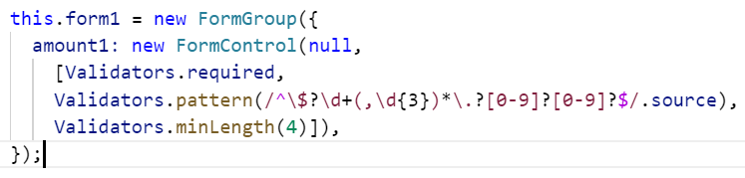
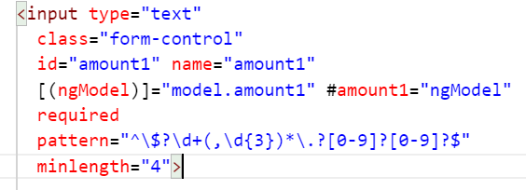
Validator:
A validator is a function that processes a FormControl and returns a map of errors. Every time the value of a form control changes, Angular runs validation and generates either a list of validation errors, which results in an INVALID status, or null, which results in a VALID status.
Reactive Form
Model Driven Form

Slide 4
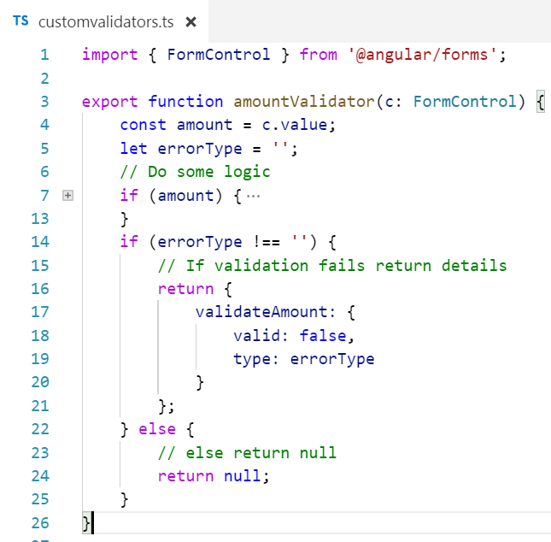
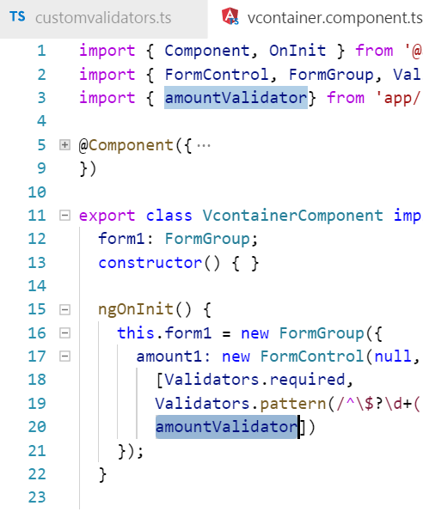
Custom Validator
Use with Reactive Form

Slide 5
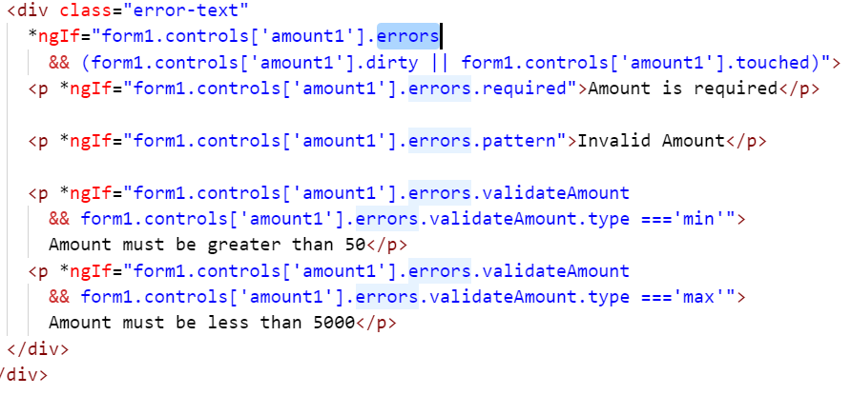

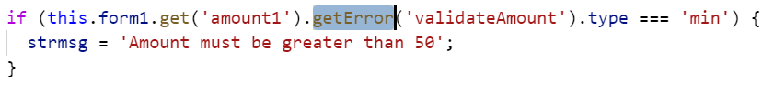
Accessing FormControl ‘ValidationErrors’

Slide 6
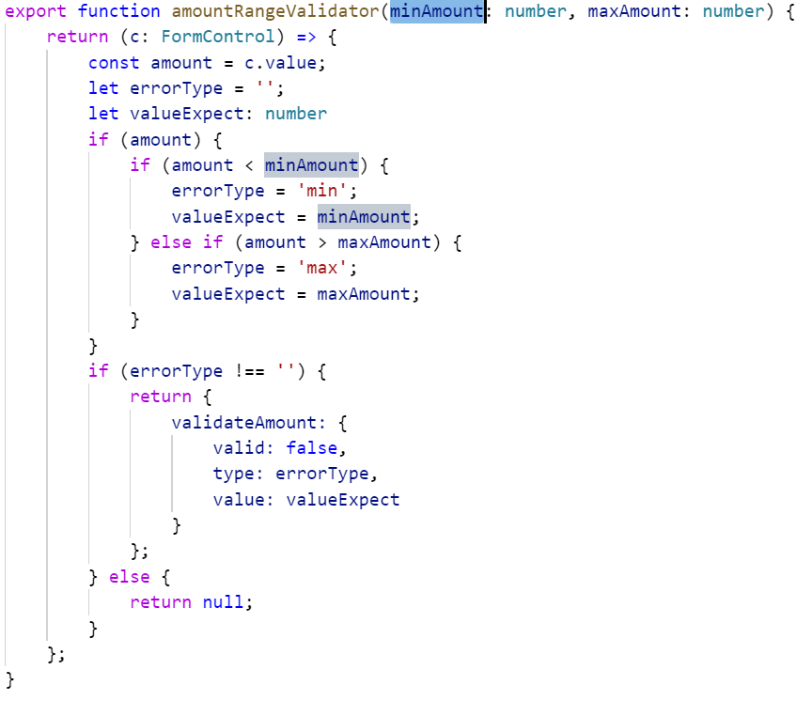
Custom Validator with arguments

Slide 7
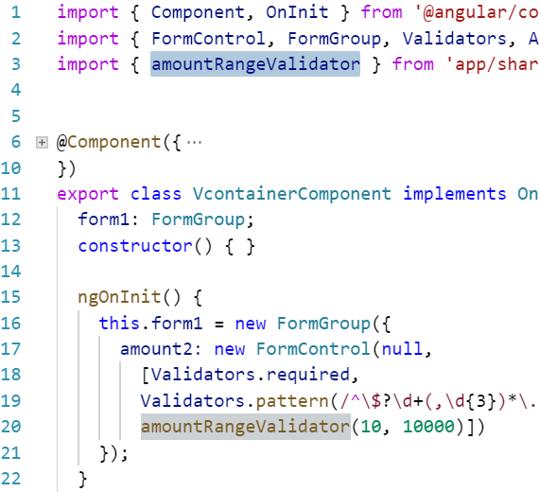
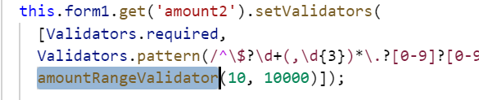
Calling Custom Validator with arguments in Reactive Form

Slide 8
Directives
Components - directives with a template <my-custom-component-dir></my-custom-component-dir>
Structural Directives - change the DOM layout by adding and removing DOM elements. <p *ngIf="form1.controls['amount1'].errors.pattern">Invalid Amount</p> <ul> <li *ngFor="let hero of heroes">{{hero.name}}</li> </ul>
Attribute Directives - change the appearance or behavior of an element, component

Slide 9
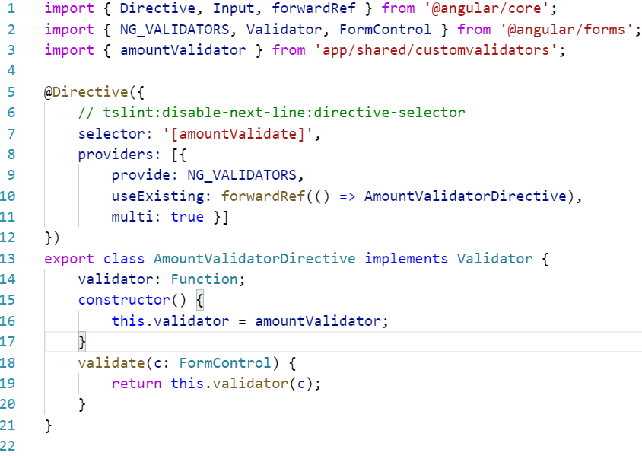

Custom Directive for Custom Validator without dependency
Directive
NG_VALIDATORS
Validator

Slide 10
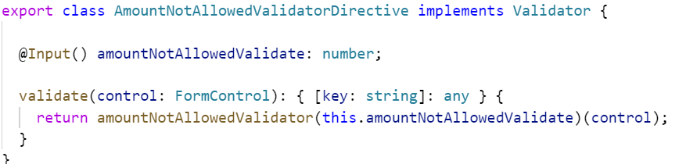
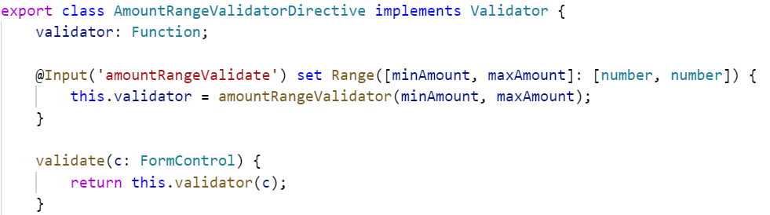
Custom Directive for Custom Validator with dependency
Single value
Multiple value

Slide 11
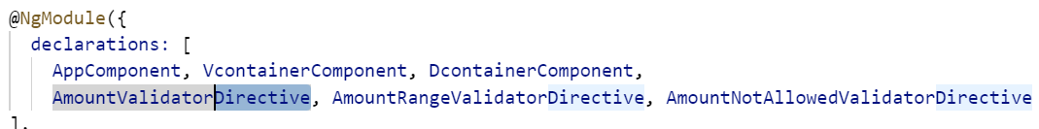
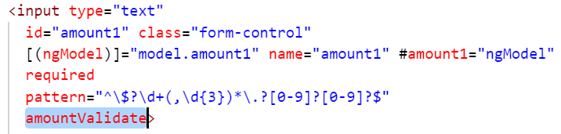
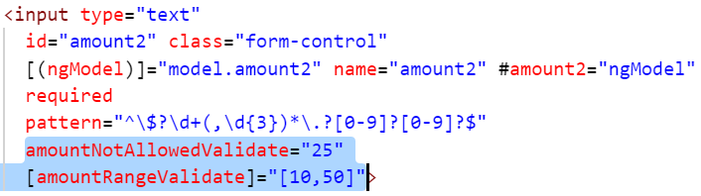
Using Custom Directive
Add Directives to NgModule declarations
Use the respective selectors of the Directives in the Form controls

Slide 12
Thank You
https://github.com/timmyktom/angular_validator_directive https://www.meetup.com/en-AU/ng-sydney/events/243754025/

